Slide 1
mobile G@ME
Developed by
Md. Raihan Masud
Md. Shihabuddin Alraji
Project Supervisor
Md. Faijul Amin
Lecturer
CSE Department

Slide 2
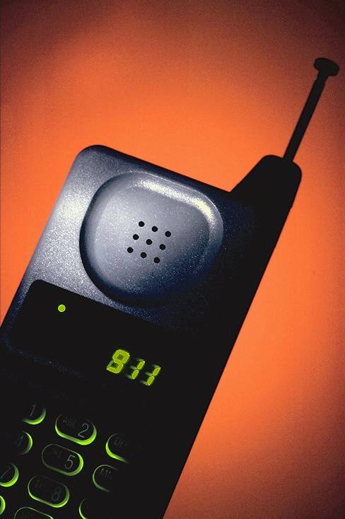

Concept of Mobile Game
Games that can be played in mobile or PDA
Java Technology for Mobile Games
Short storage supports for Mobile Game
Recent Mobile Phone support for Games

Slide 3
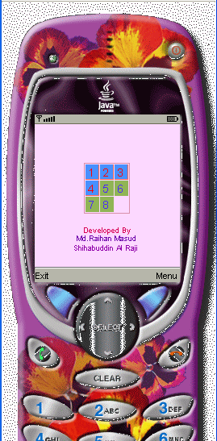
Game name: Number Game
It is a puzzle game.
Initially digits from 1-8 are placed in ascending order sequence in eight boxes.
At the beginning digits will be shuffled in irregular fashion when the play button press.
Player’s task is to rearrange the digits.
The the lower the move number the higher credit goes to the player.

Slide 4
Technology & Resources used
Java 2 Micro Edition(J2ME)
J2SDK 1.4.2_06
J2ME Tool Kit 2.0
Third Party Interfacing Software
Data Cable

Slide 5
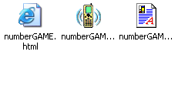
Code & Logic
Game is developed in Computer first. Very Simple logic is used. Inside a larger rectangle of fixed parameter, nine rectangles are drawn . These rectangle are drawn by using nine objects having Co-ordinates , colors & the single digit associated with them each. On pressing play button or movement keys ,a shuffle function is used to shuffle the co-ordinates of the objects. After each call to the shuffle function the paint function is called to draw all the nine rectangles at a time on the display screen of the mobile phone . While on this continuous process if all the co-ordinates of nine objects are similar to initial ascending order , the player is rewarded with the victory.
After developing the software with J2ME Wireless Toolkit 2.1 a Package has been made that include a JAD file and a JAR file. The JAD file can be executed with built in Emulator with the Toolkit as for test with the option Run MIDP Application.

Slide 6
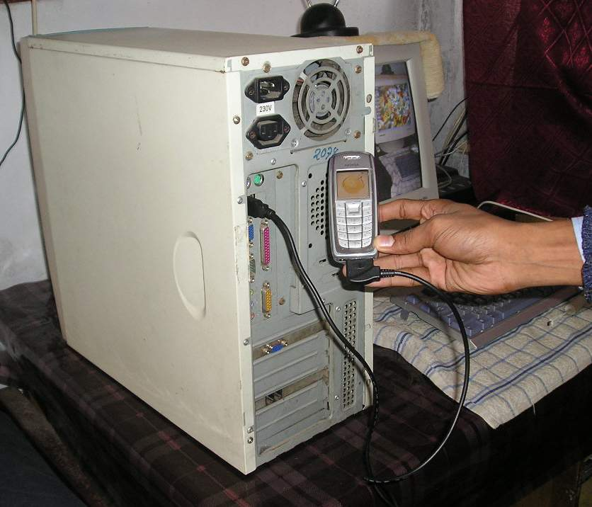
Mobile Connectivity
Our Software Package name numberGAME.jad & numberGAME.jar can be directly download from PC to Mobile with the help of a data cable (connecting PC & Mobile set) and a third party Interfacing Software available with Data Cable or website of the Phone Company.

Slide 7

Thank you

